Slide 1
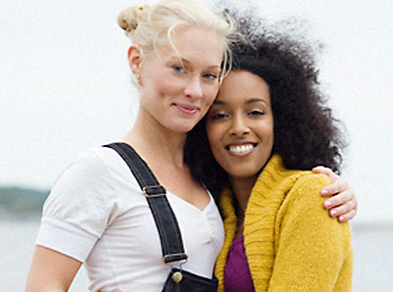
Attraction & Mate Selection
Notes:
Attraction and Mate Selection
Today it is a lot more complex than it used to be when it comes to making decisions about partnering
Young adults are concerned about whether they can form a satisfying, successful, lifetime relationship and still be true to themself
Do they want to be married, live common law, stay single, and if they figure that out, what type of person if another is desired will that be? Exogamous? Endogamous? Gender? Orientation? And so on…
“historically and in many cultures today romantic love is considered a hindrance to marital stability” (Kelman 1999 cited in Holloway et al 2003)
While some Canadians today are partnering due to arranged marriages, many intimate partnerships in Canada are the result of free choice – termed officially as free choice mate selection
Free choice is usually based on attraction and romantic love and sexual attraction – although is this a biological phenomenon or a social construct????

Slide 2
intro theories regarding attraction & mate selection…
natural selection
social homogamy
ideal mate theory
older men & younger women
attraction as fair exchange
social exchange theory

Slide 3
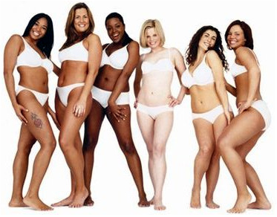
natural selection
Notes:
natural selection (evolution) mate selection preferences are based on reproduction and passing on traits to our offspring that will ensure / improve survival > the idea is that attraction based on finding these traits
example of study in rainforest on attraction > showed men photos of many different type of women and the ones that they seemed most attracted to were physically built for bearing children – wider hips, strong and healthy looking – as opposed to popular media representations of “beauty” today which is more thin
David Buss looked at research in 37 cultures and determined that people are still attracted to the person with whom they can raise the most successful children – though we don’t realize that we are programmed that way (it is in our subconscious)
universally it seems men are more attracted to what appeals to them as physically healthy and able to reproduce – so women who are young, healthy, attractive, shiny hair full lips, curves etc.
felt that women marry “up” to ensure survival of their children and themselves and are attracted to in the past physically capable men but in today’s society that extends to intelligence, education, work ethic etc.

Slide 4
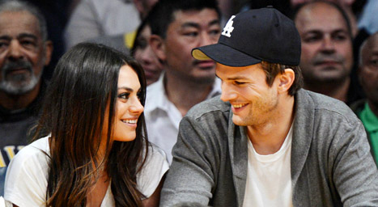
social homogamy
Notes:
social homogamy is a theory that individuals are attracted to people from similar background with similar expectations and beliefs
The highest correlations are between age, race, ethnic back ground, religion, socio-economic status and political views
proximity is a key factor in today’s society > people fall in love with and marry those who live and work nearby etc.

Slide 5
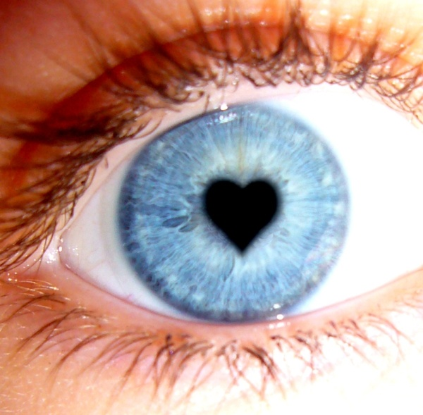
ideal mate theory
Notes:
ideal mate theory states that attraction is based on the unconscious image of an ideal mate, formed on our own interpretations (symbolic interactionism)
perceptions of love at first sight is simply a recognition of what you knew you wanted

Slide 6
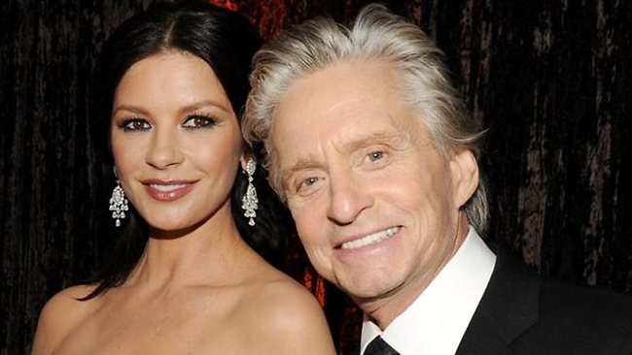
older men & younger women
Notes:
older men and younger women
Men marry younger women worldwide
The average age difference in Canada is 2 years (this is one of the lowest in the world)
In Iran the average age diff is 5 years and this is one of the highest
Age diff can be explained by evolutionary psychology – older men who have proven resources are considered more desirable in all societies (will be able to help protect babies) and younger women are considered to be more sexually desirable (some would say this is because of fertility)
Feminist view – this ensures domination – more traditional values / may be more in favour of the male being older
Exchange theory – its all about what you bring to the table

Slide 7
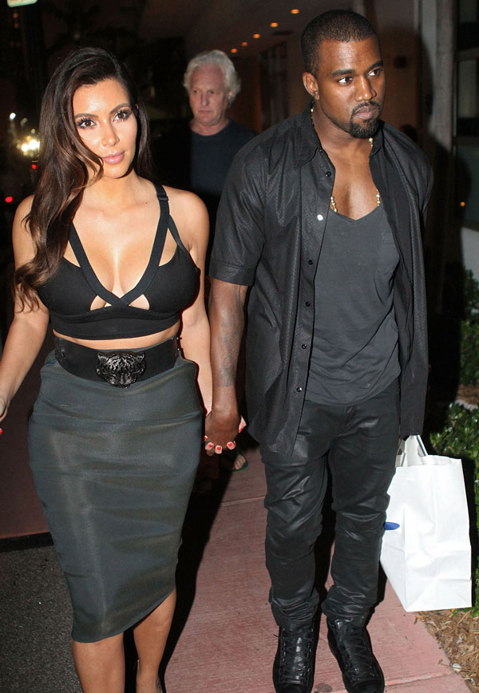
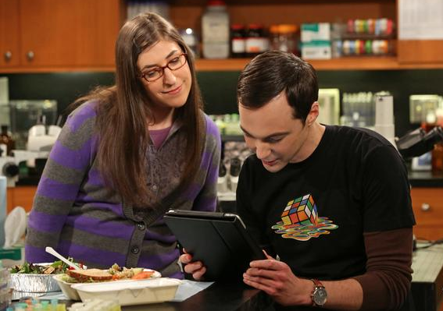
attraction as fair exchange
Notes:
attraction as fair exchange looks at how individual preferences help determine who is attractive to us
But who we are interested in may not always be reciprocated - In most societies we are competing for our partners
Almost everyone is able to find a mate in his or her society because we are thankfully attracted to diff sorts, and we may not see what they see in their partner
Attraction is based more on what people really are like than on what is ideal
People assess what they have to offer and look for the best possible mate who will be attracted by their resources – a lid for every pot

Slide 8
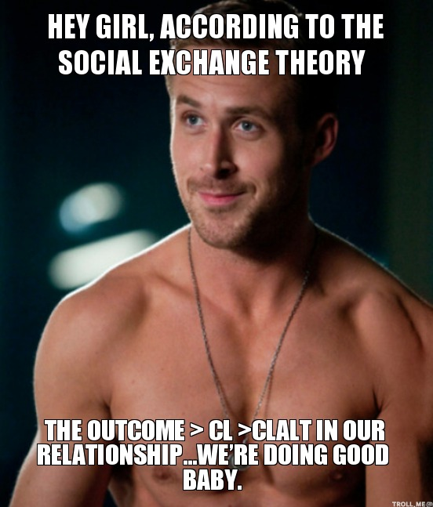
social exchange theory
Notes:
social exchange theory is that people are attracted to a ‘good deal’, people will marry a ‘good deal’ and vice verse and will do what they need to, to keep a ‘good deal’
CL stands for Comparison Level and CL for Comparison Level Alternative

