Slide 1
Family Life Cycle Stages
Developmental Theory

Slide 2
Individual Development
As we all grow and enter different phases in our lives, we go through various challenges and conquer milestones unique to that phase.

Slide 3
For example, in the first few years of life, a baby is dealing with learning to trust his or her caregivers,

Slide 4
whereas the main task of a teen is the need to figure out their own identity.

Slide 5
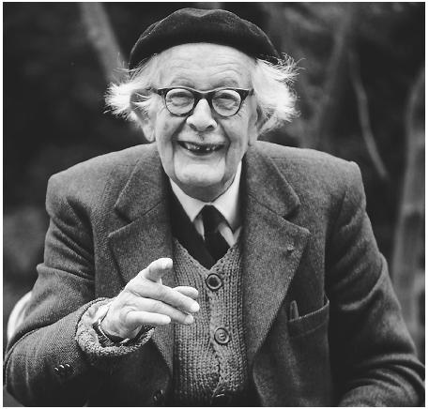
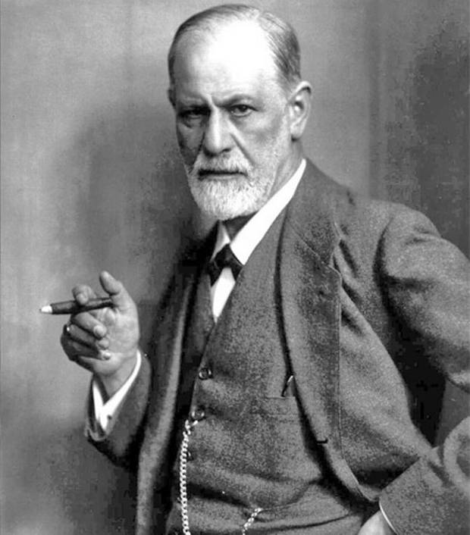
Developmental Steps
The developmental steps that we go through have been explained by theorists like Erik Erikson,
who proposed the previous examples of the psychosocial growth of children and teens,
and other theorists who have studied brain development, or psychological maturation and so on.

Slide 6
But the stages an individual goes through during life are not the only type that counselors should pay attention to.
for family therapists and those who study the family , it is also important to understand that the family itself has its own stages of development.
This can be described by the family life cycle theory, or the theory that there are a series of developmental stages a family moves through over time.

Slide 7
Family Life Cycle Theory Key Ideas
Families, like individuals go through predictable stages.
Example: marriage-first child-child goes to school- leaving home
At each stage there is a key principle of transition.
Example: commitment to new system
At each stage there are 2nd order changes otherwise known as tasks or challenges that must be solved in order to move on to next phase.
Example: form new partner system, adjust other family relationships and friendships to accommodate new partner

Slide 8
For example

Slide 9
As families develop, they should ideally try to accomplish these changes or tasks for success, so these are areas that therapists often focus to see if they can lend support and make recommendations for areas that can be worked on by members of the family.

Slide 10
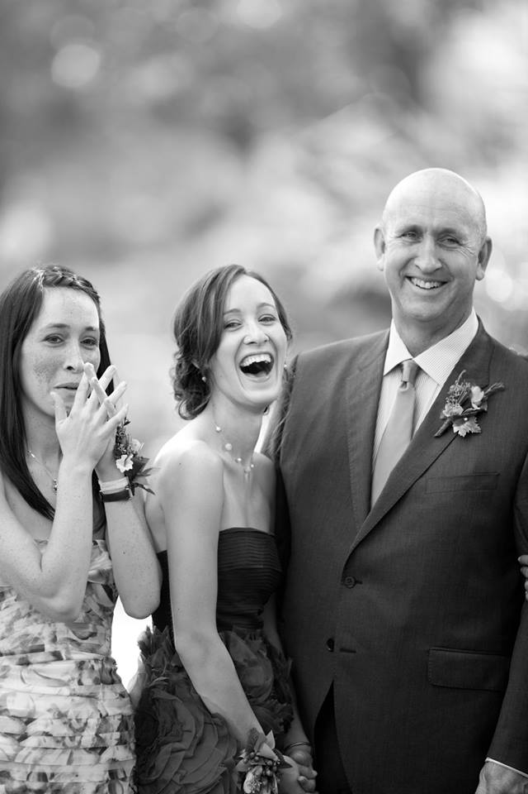
Just like there are challenges specific to each stage, there are also unique joys as well

Slide 11
Your Assignment
Get into 7 small groups,
Select a stage, first come first serve – sign up with teacher
Begin to research specifically for that stage,
the key transition principle
the 2nd order changes or tasks
unique challenges
unique joys
Plan your family stage box,
what types of articles will you include to communicate your findings in each of those four areas?
Who can bring what and so on, exchange contact information
Plan an interactive activity,
that you will use with the other visiting groups, [round robin rotation like a science fair] to enhance their understanding of your particular stage

